Slide 1


Data Visualisation Tableau & Python Practical Presentation
Submitted by:
Muktesh Sahu (10594774)
Maya kumbhar (10594952)
Ankit Butola (10590492)

Slide 2
Task 1: Using Tableau, conduct visual analysis to explore the possible reasons behind customer churn.

Slide 3
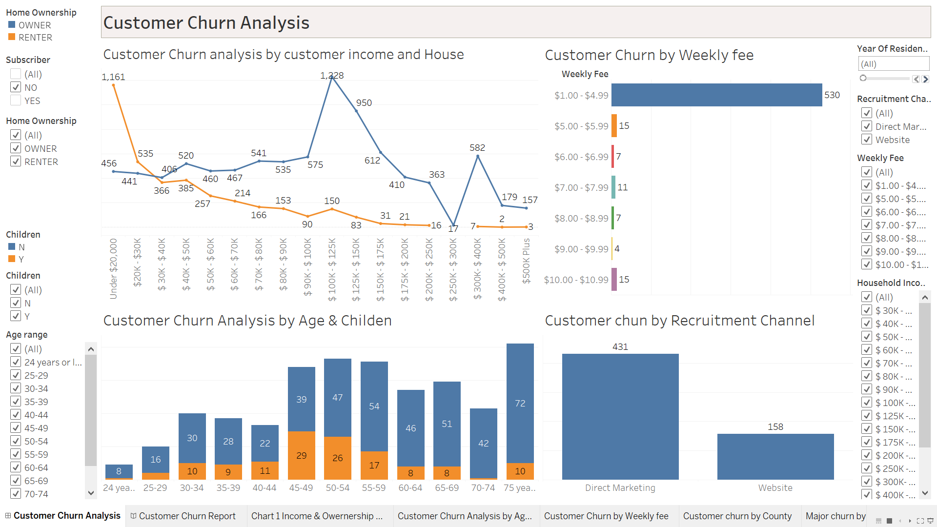
Customer Churn Analysis Dashboard
Customer Churn analysis by customer income and house ownership
Customer Churn by Weekly fee
Customer Churn by subscriber Age & Child Status
Customer Churn by Recruitment Channel
Customer Churn Report - Story

Slide 4
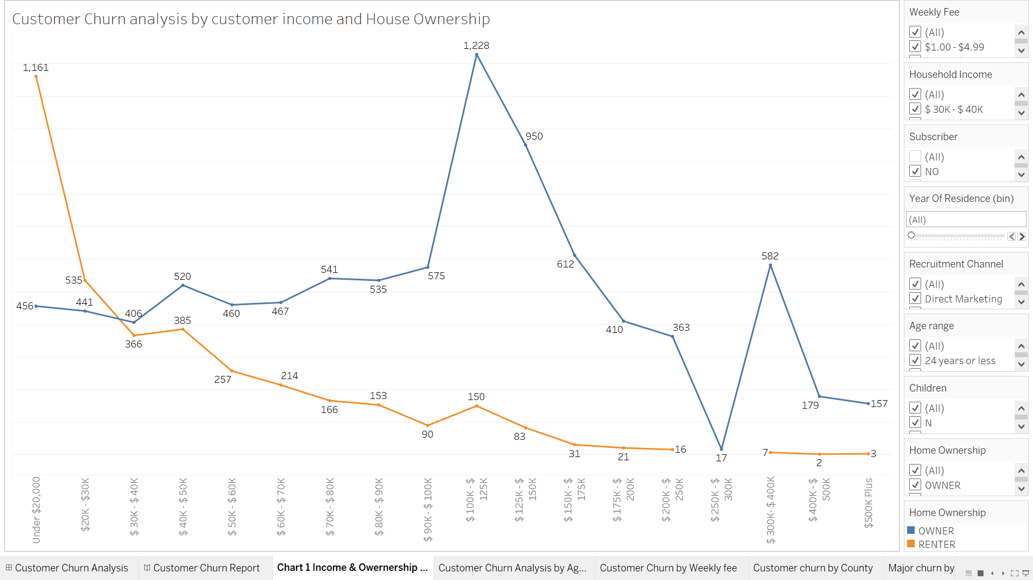
Customer Churn analysis by customer income and house ownership
In this trend chart, Orange line represent "House Rented Customer" and blue line represent "House Owned"
It is clearly seen, rented customers who come under least salary range has the highest customer churn and the churn start decreasing by moving salary range. So, the possible reason here is the customers who have less income cant afford the subscription.
Reason for churn in case for 'House owned' customer is not income. As you can see customer churn count is moreover similar in initial salary range but it kept on increase by increasing the income and then gradually decrease till 250K range. Hence in every range we see customer churn but income more than 100K has less churn.

Slide 5
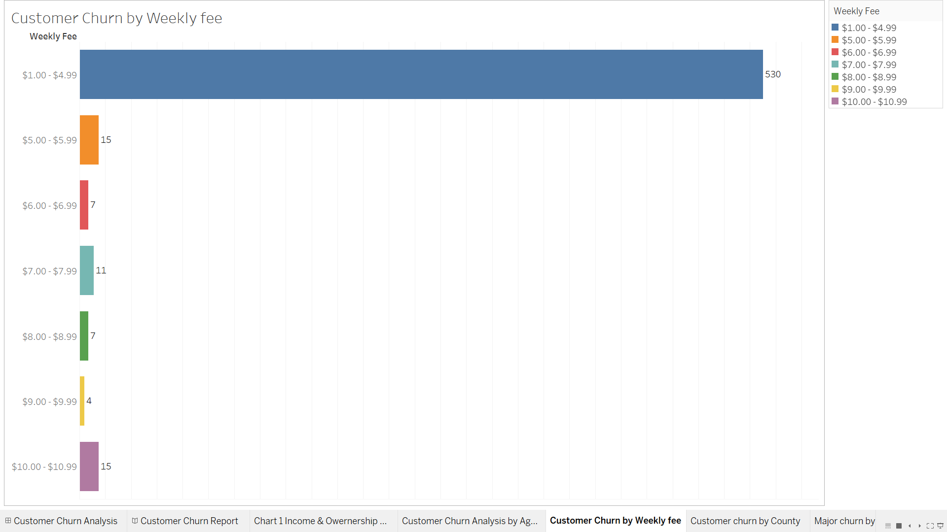
Customer Churn by Weekly fee
This Bar chart clearly shows that the majority of customers who left the subscription are having the basic subscription plan which has weekly fee from 1 dollar to 5 dollar. Possible reason behind customer churn might be the basic subcription plan which customer get the same from another company at less price or it might be the plan.

Slide 6
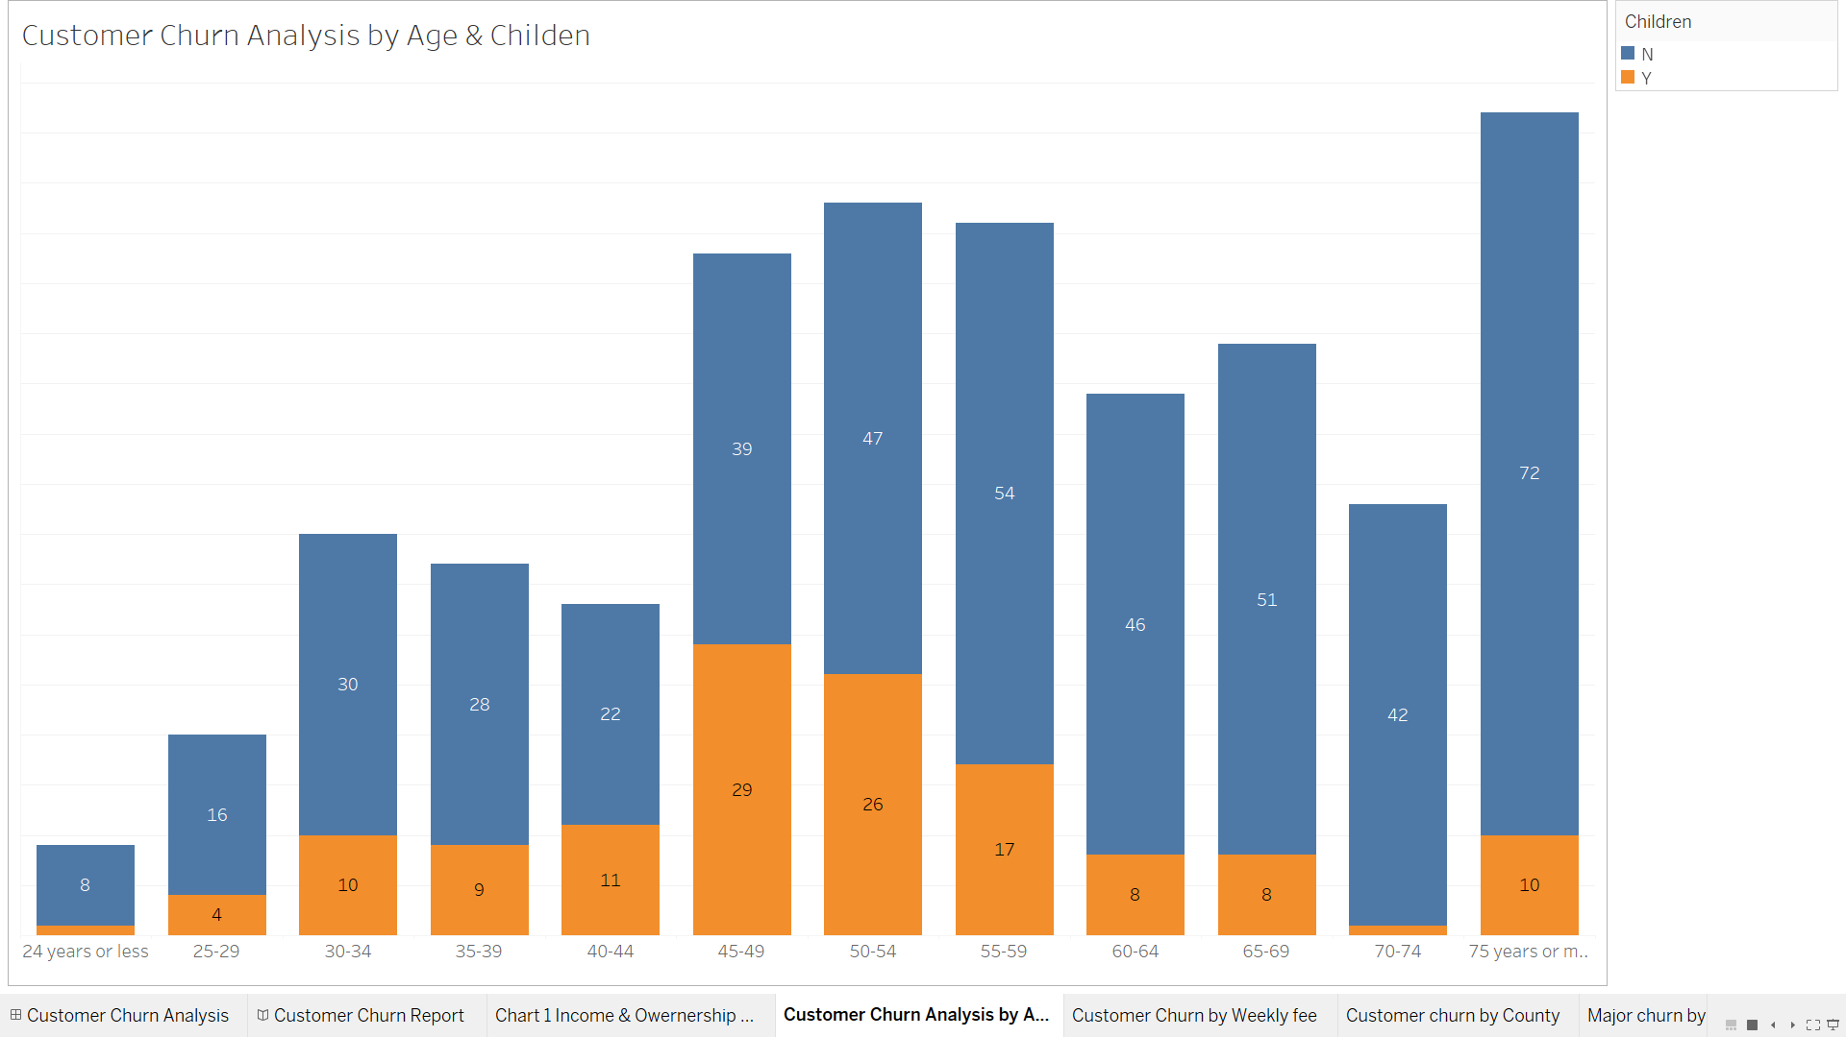
Customer Churn by Subscriber Age & Child Status
Through this bar chart, we can see customer churn increase by increase age group in both category having child and no child. To conclude on this chart, higher age group has high churn rate and people with child and no child having the similar analysis which mean children is not depanding on customer churn.

Slide 7
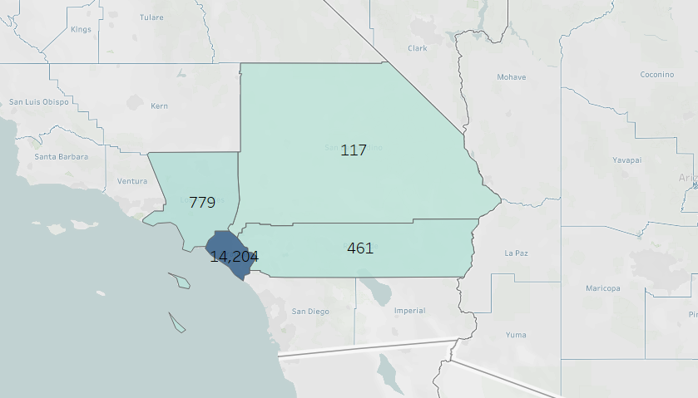
Customer churn by County
It is very clear by looking at the map, majority of customer churn are happen in county "Orange" and least in SAN BARNADINO.

Slide 8
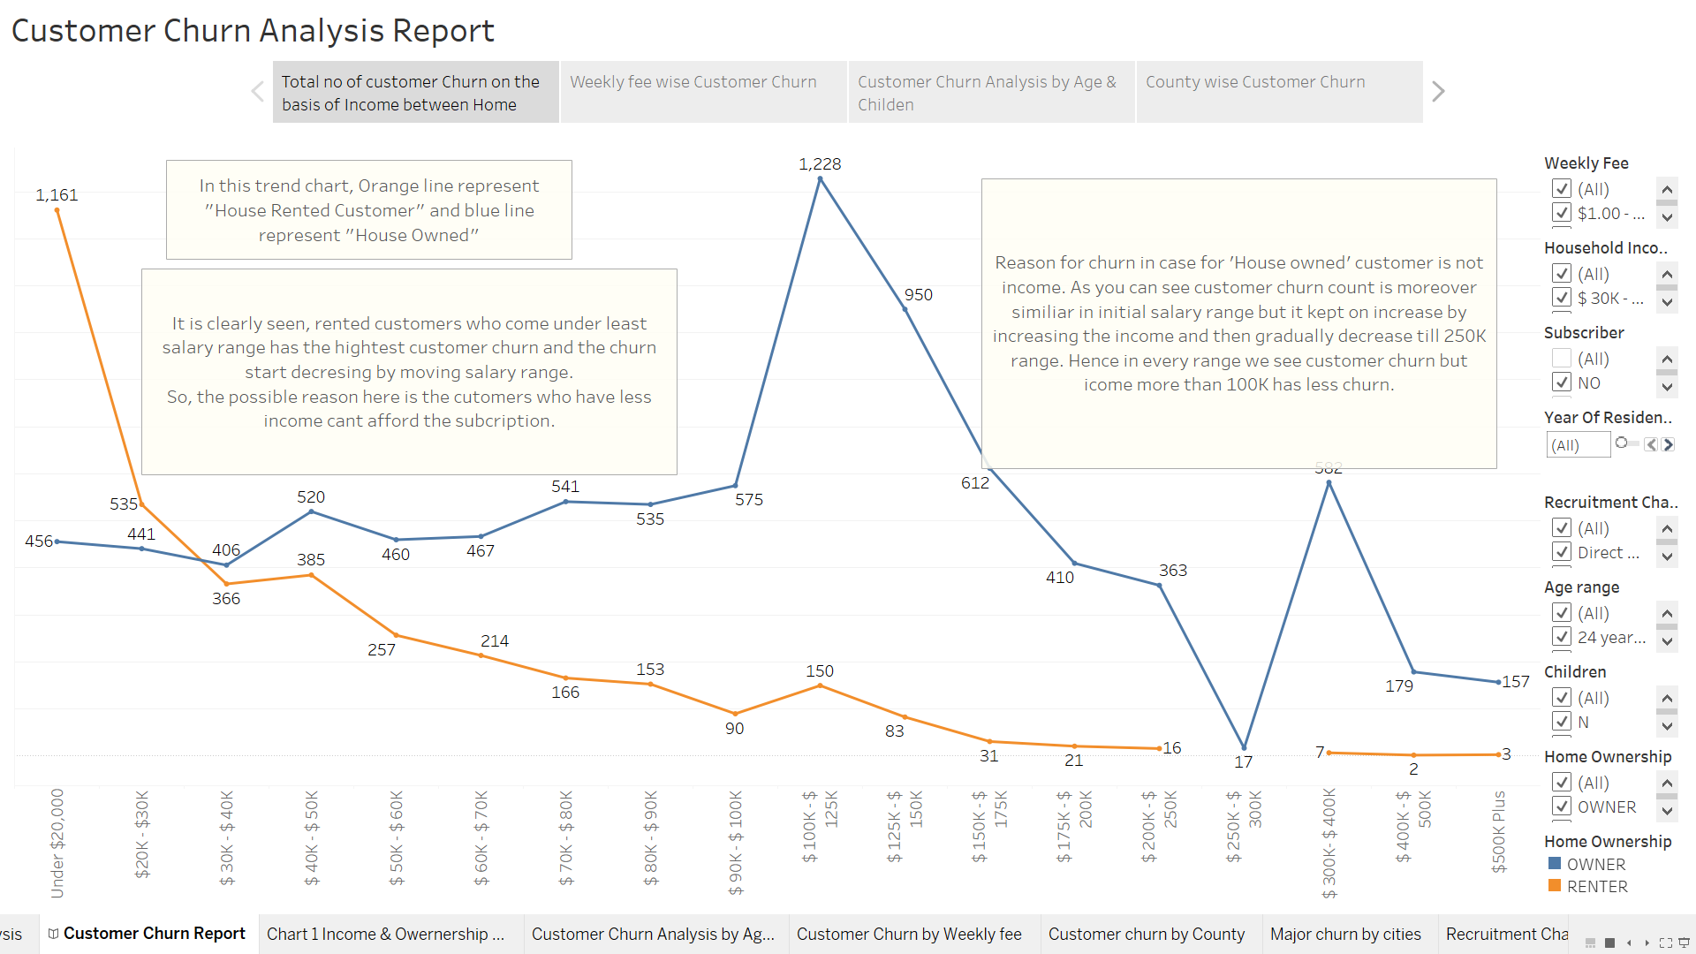
Story: Customer Churn Analysis Report
Prepared Tableau story report to explain why customer churn happen by using important dimension like Age group, Income, Child, Recruitment channel, etc.

Slide 9
Task 2: Using UMAP dimensionality reduction technique in Python, conduct visual analysis to answer the following questions: 1. Can you identify any clusters of forest patches? If yes, then describe these clusters. 2. For each of the seven trees mentioned in the data, can you identify the characteristics of forest patches where a particular tree type might be present predominantly? 3. Are there any tree types which can grow in more diverse environments?

Slide 10
UMAP dimensionality reduction technique using Python
Importing dataset & Dataset information
Dividing dataset into label & features
Normalizing numerical features
PCA Implementation
UMAP implementation
Observations

Slide 11
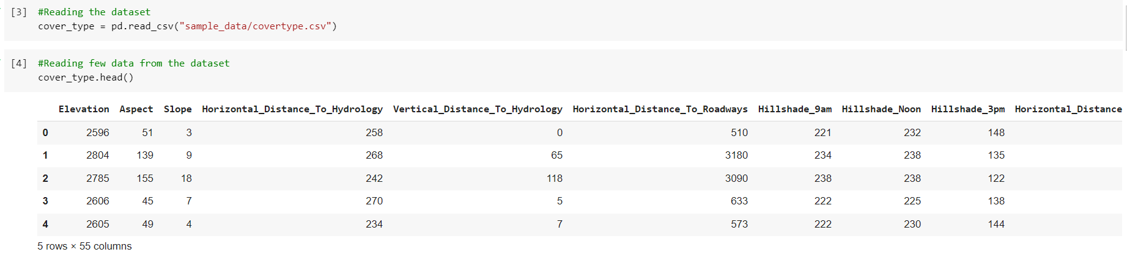
Importing dataset & its Information

Slide 12
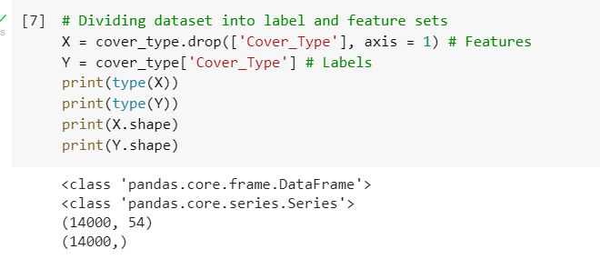
Dividing dataset into label & features

Slide 13
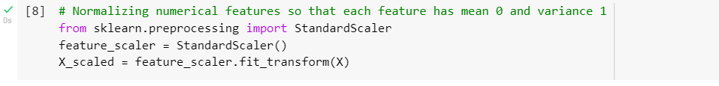
Normalizing numerical features
Normalizing numerical features so that each features has mean 0 and variance 1

Slide 14
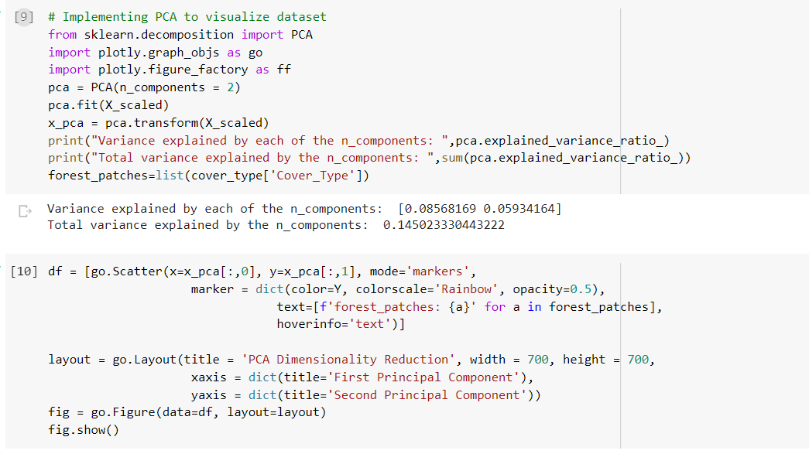
PCA Implementation

Slide 15
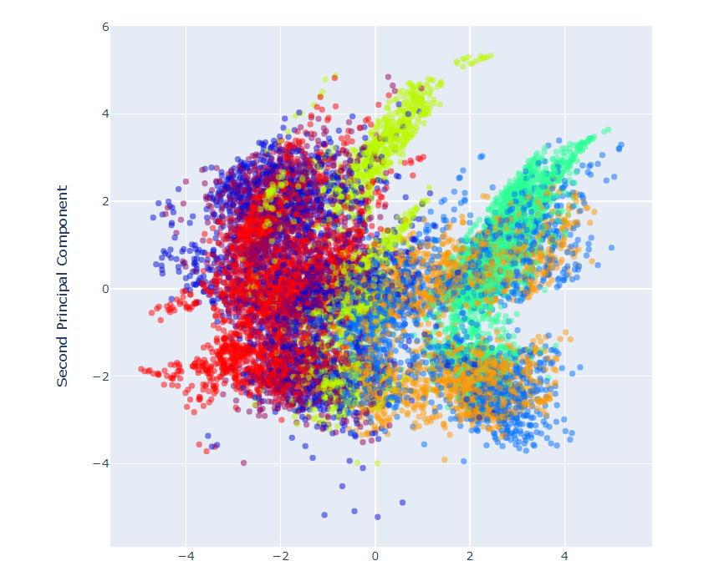
PCA Output

Slide 16
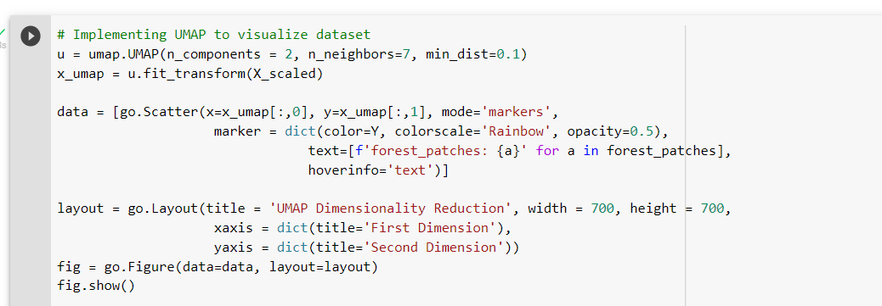
UMAP implementation

Slide 17
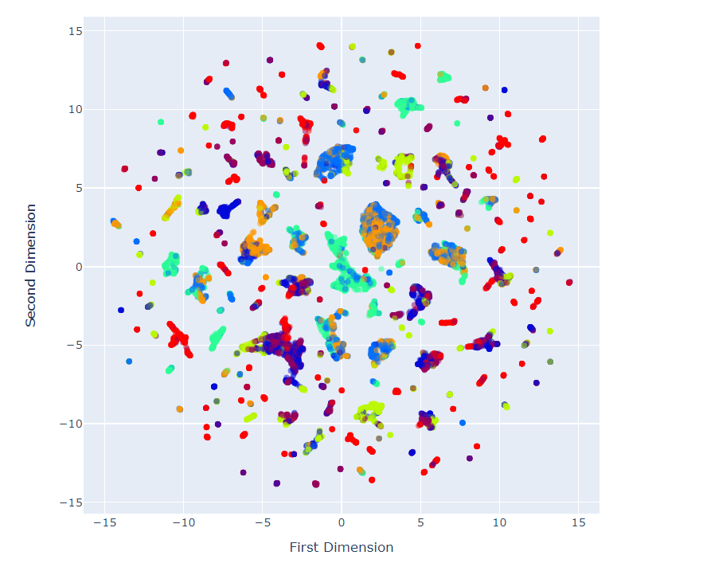
UMAP Output

Slide 18
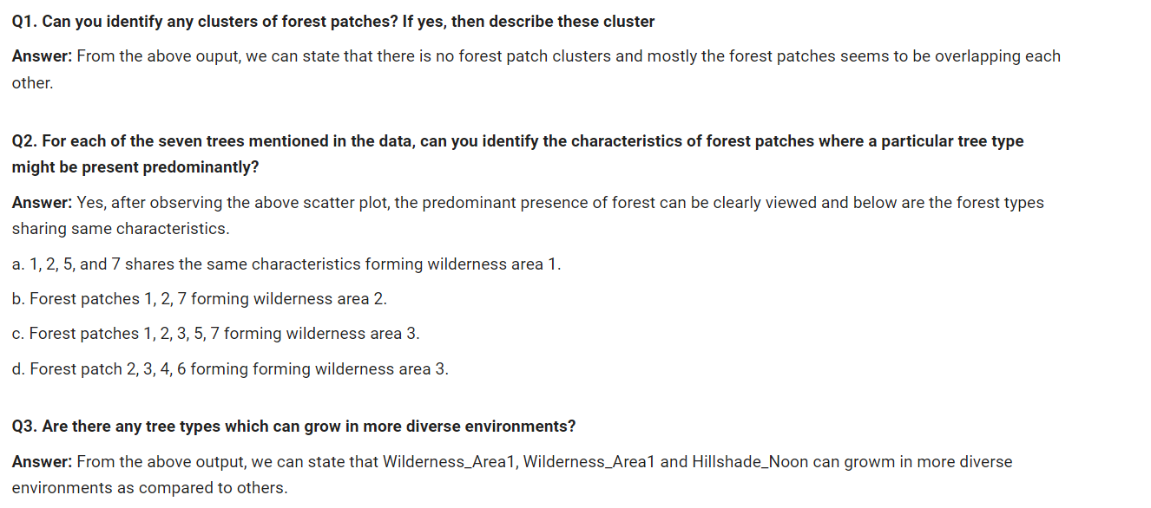
Q&A
4

Slide 19
Team Contribution
In Order to complete this assignment, we create a group of three member, Muktesh Sahu (10594774), Maya Kumbhar (10594952), and Ankit Butola (105902492). we discussed about the tasks and the possible challenges that we might face while completing the same, as the assignment was really practical and interesting. At First, we parted the assignment into two portions and decided the best possible approach to complete it and at the end, each of us ended up working for both, Task 1 and Task 2.
Muktesh Sahu – After detail discussed on both the tasks, I have started working on task 1 where we need to find the possible reason why customer is churn. We have given data in excel format and I have start task 1 assignment by fetch data in tableau and start exploring dataset and their attribute. Thought the data is little complicated to understanding but after creating different visualization and analysing data based on filter and charts makes some sense. Create different visualization, Dashboard, Story and explained each part to answer reason why customer churn and validate data from source excel. I also help Ankit and Maya to find solution for task 2 and presentation.
Maya Kumbhar - I have been working on task 2, Firstly I took some time to understand the dataset properly which was provided to us in csv format. After having knowledge of all the attributes from the dataset, I imported the file to google colab using python code, since this task focused on using UMAP dimensionality reduction technique to conduct the visuals in python, I installed required libaries and useful packages. Firstly, I divided the dataset into labels and features, normalized the numerical features so that each of the feature has mean as 0 and variance as 1. After this step, I have implemented a PCA and UMAP and plotted them using scatter plot and from the output, I was able observe and answer the questions asked for this task. After successfully implementing this task, I have shared and explained task 2 to rest of my team members.
Ankit Butola - As part of this assignment, I have been working parallelly with Maya and Muktesh to gather the relevant information in order to provide the best solution for the tasks. Task1: After thorough understanding and analysis of the customer churn dataset, I have volunteered to work on the following visualisation “Customer Churn by Weekly fee” and “Customer churn by County” , I have used a tableau bar graph and a geographical map respectively. Also, stated the insights as well in the above slides. Task2: Understanding the important algorithm like UMAP was interesting and useful to start working with dimensional reduction. I have referred few internet resources such as “umap-learn” and content provided on moodle page. I have used the sample code file provided on moodle and tweak it as per the task 2 requirements. I have used libraries from sk-learn package and other libraries such as plotly and pandas in order to implement PCA and UMAP.

Slide 20
Thank you !!

